Slide 1
2018 Kansas City Crime Analysis
Amber Vasser, Laylaa Tariq, Vamsi Navuluri, John McBride

Slide 2
Outline
•Assumption
•Objectives
•Data Sources
•Analysis
Total/Types of the number of crimes for 2018
Total/Types of crime by Month in 2018
Types of crime involvement by Gender/Age group
Police Divisions locations of crime occurrences
•Future Considerations
•Conclusions

Slide 3
Assumption
•Our group assumption for the 2018 Kansas City, MO crime data was that the greatest type of crime committed would be stealing(larceny/theft) by young males during the “Winter” months in urban areas.

Slide 4
Objectives
Examining the relationships of crime in Kansas City, MO in 2018.
What type of crime is most common among different areas based on the greatest number of people involved in the crime?
Do different times of the year affect the number or types of crimes committed? Crimes by Month in 2018?
Does the age or gender of the people involved in crime play a role in determining the greatest participants in criminal activities?
Where is crime most likely to occur in the city limits of Kansas City?

Slide 5
Data Sources
Open Data KC : KCPD Crime Data 2018
Types/Number of Crimes
Months of the year in which crimes occurred
Gender and Age of people involved in crimes
Police divisions locations of where crimes were reported
<https://data.kcmo.org/Crime/KCPD-Crime-Data-2018/dmjw-d28i>
ArcGIS : KCMO PD Division Stations
Locations of KCMO police divisions within Kansas City, MO metro
<https://www.arcgis.com/home/webmap/viewer.html?webmap=1467294e9dc24839bbe55f61607c3151>

Slide 6
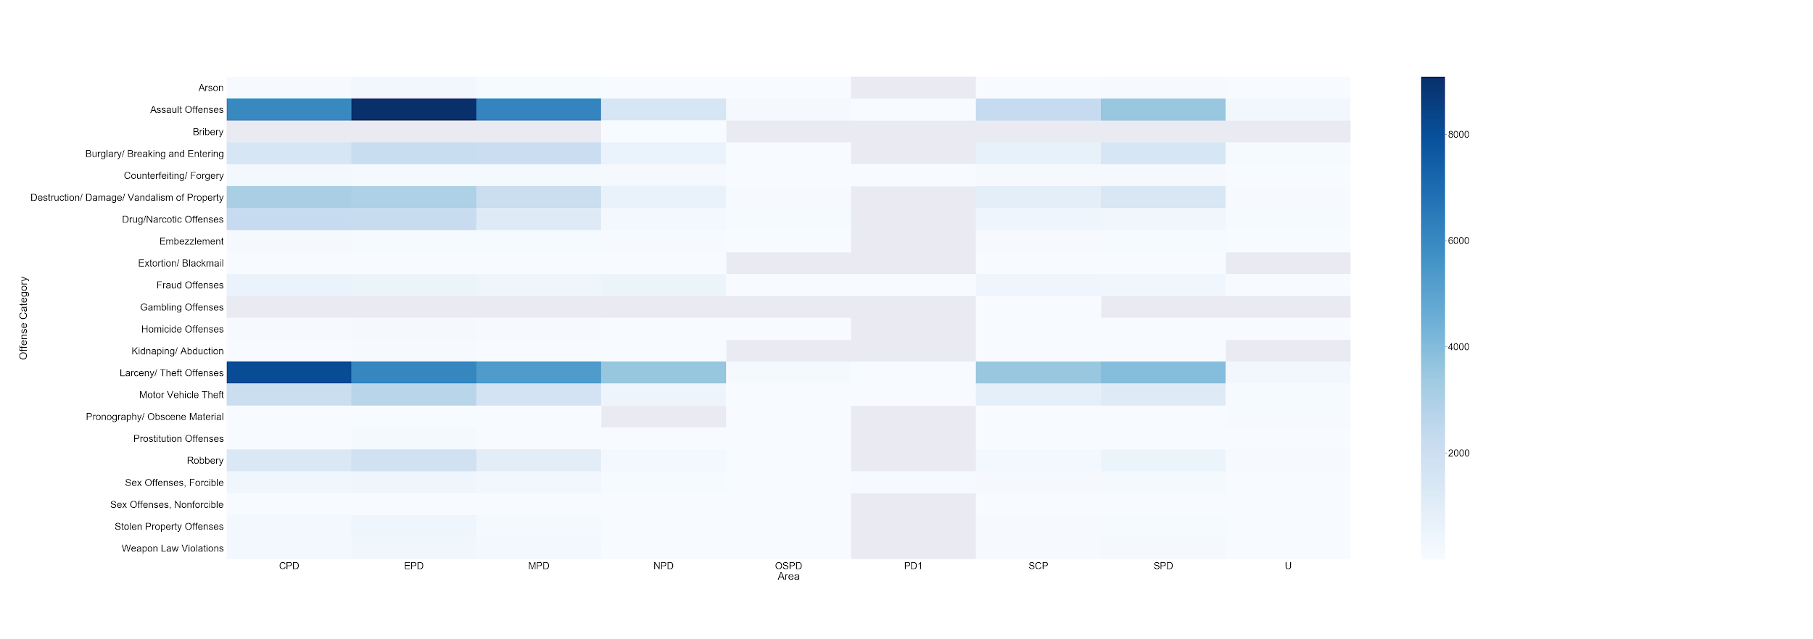
Crime Category vs Area vs no of People Involved
Initial assumption was that theft would be major contributor to crime rate.
Based on the heat map ‘Larceny/Theft’ and ‘Assault Offenses’ are the major contributor to crime in urban areas CPD - Central, EPD - East, MPD - Metro divisions of the city.

Slide 7
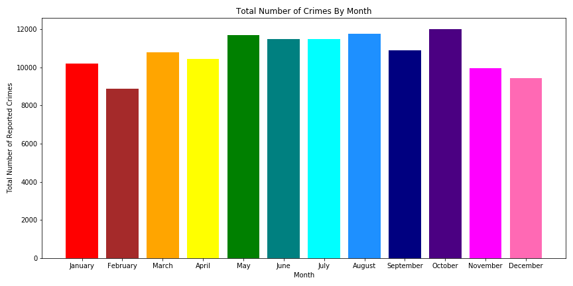
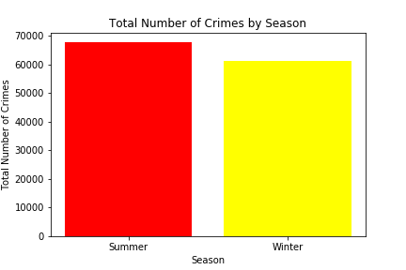
Total Number of crimes In Kansas City by Month in 2018
In the initial assumption we considered winter to be the season with highest number of crimes
First plot shows the number of crimes over the course of the month keeps fluctuating, does not tell us whether winter has a higher rate
Divided months into two groups summer- warmer months, and winter - cooler months
But the second plot negates our assumption
Difference in winter and summer, but is the difference significant?
Ran statistical analysis by Season:
P - Value < 0.05(6.25 *10^-73)
Difference matters
Curious if the change in months affect the crime rate
Ran analysis by quarter and month
P - value < 0.05 for both
Does matter

Slide 8
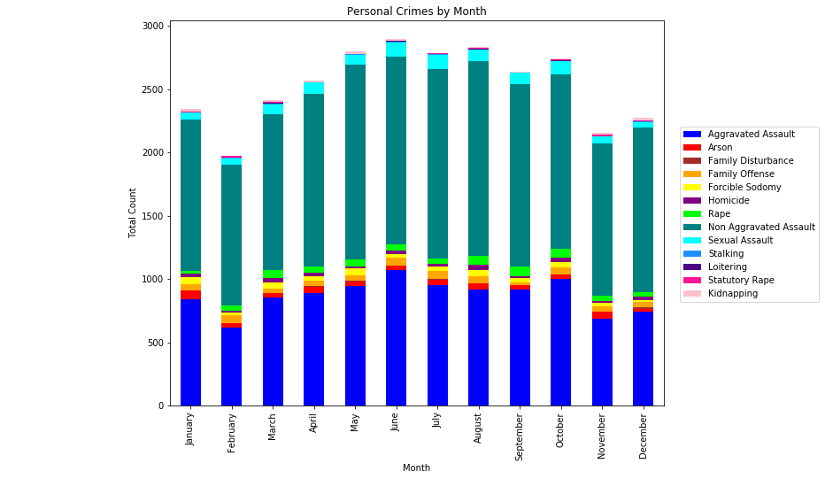
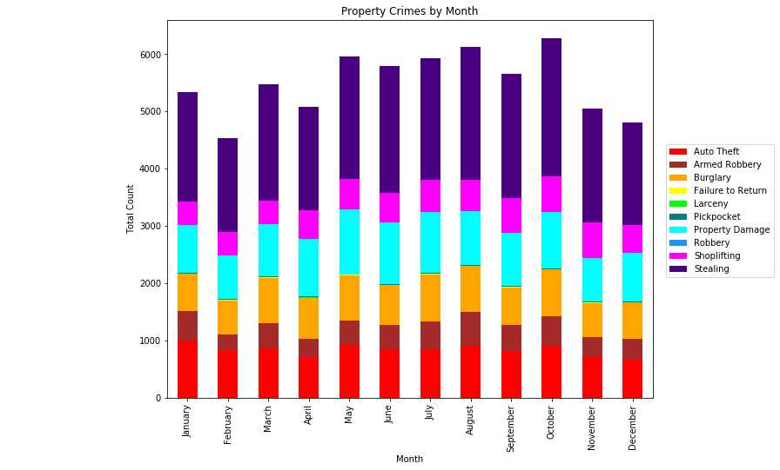
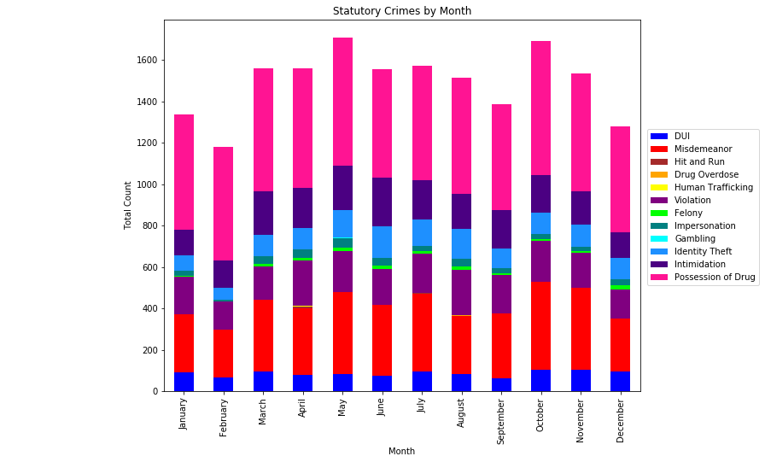
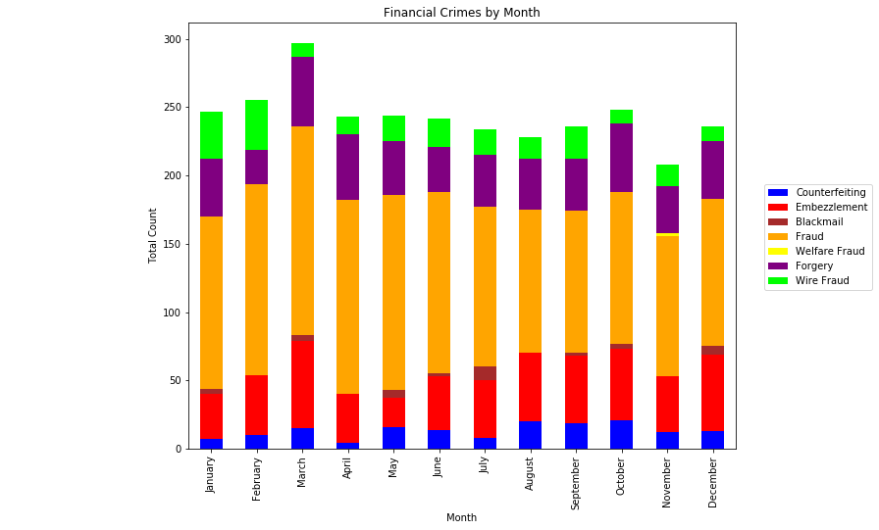
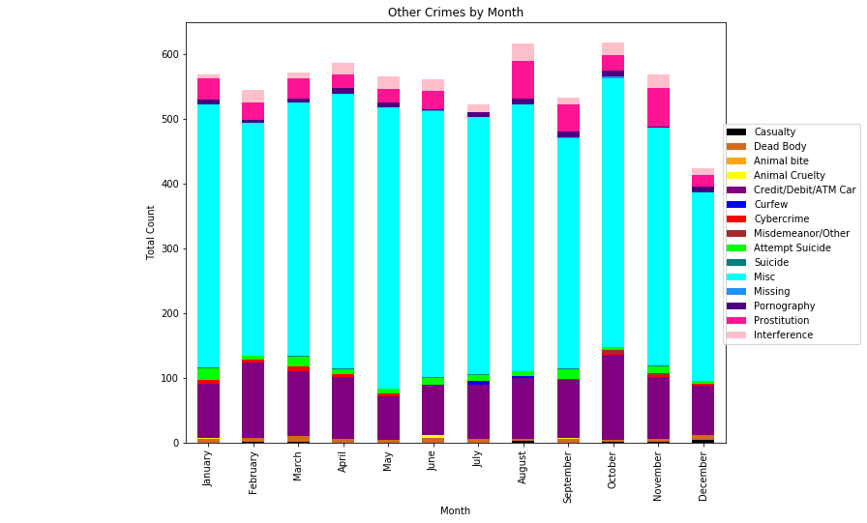
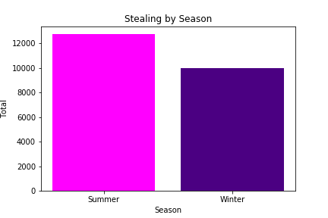
Total Number of Crimes by Categories by Month
Total 122 different types with repetitive or same type described differently
Condensed to 66 types, still too much to display on one graph
Broke down into categories
Property crimes with the highest total, contains sub - category “Stealing”
Change looks pretty consistent
Still want to find out if the change in month does affect different types of crimes
Further drilling was still required to justify the assumption
Assumption partially correct, most committed crime - Stealing
Rate higher in summer

Slide 9
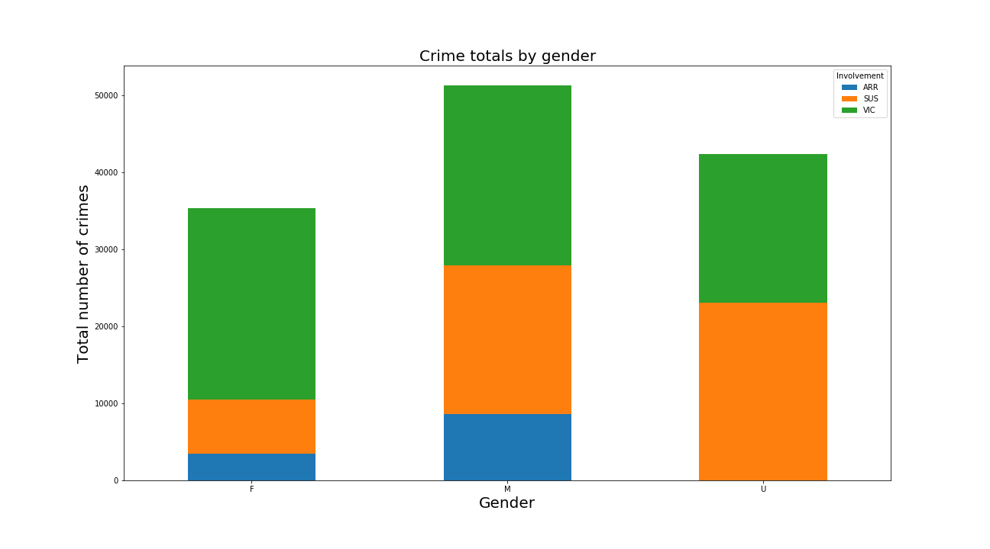
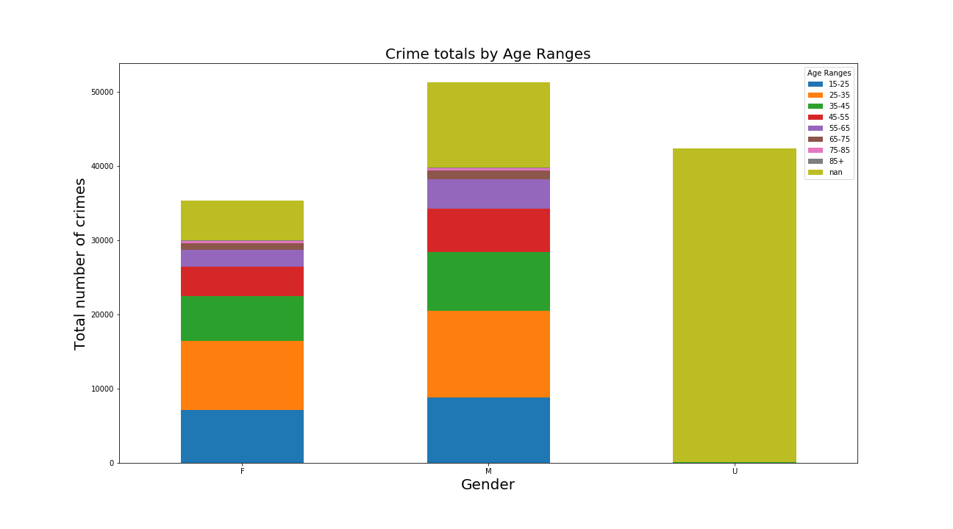
Crime outcomes determined by Gender/Age
Women were the lowest participants in criminal activities and only slightly more likely to be a victim of a crime than Males. Males were the greatest participants in criminal activities.
Males in the 25-35 year old age bracket had the highest number of crime involvement totals for any age bracket or gender. The Unknown columns on both graphs are present since the majority of the Unknown were reported crimes were a suspect was not arrested so no gender or age data was available or recorded in the dataset.

Slide 10
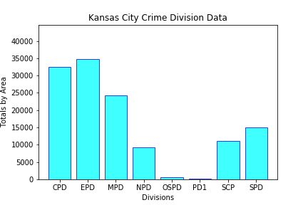
Total Number of Crimes per Police Division
Each division of each metro area of Kansas city which were:
o CPD- Central Patrol Division
o EPD- East Patrol Division
o MPD- Metro Patrol Division
o NPD- North Patrol Division
o SCPD- Shoal Creek Patrol Division
o SPD- South Patrol Division
o OSPD-Other crime PD 99999 zip code data
o PD1- PD1 unknown
EPD- 34,723 Highest number of total active crime (Urban)
SPD- 155 Lowest number of total active crime (Rural/Suburban)

Slide 11
Future Considerations
Would the police be able to use this data to determine where the best location would be for planning any future hot spot policing, camera locations and or future police stations in the Kansas City Metro to have the greatest impact on high crime areas?
What factors correlate to the rise in crime? Time of the day? Weather?Look at the pattern over years?
How do patterns in the urban areas and poverty rates play a role in determining the crime rate of particular areas in Kansas City, MO?

Slide 12
Conclusions
Open Data KC : KCPD Crime Data 2018 had an adequate variety of categories in the dataset that provided us with a large amount of data allowing us to investigate our assumption.
With being such a large dataset having 129k rows it did require some thorough cleaning on our end to make sure we were investigating with clean data.
Our assumption was proved partially correct in that our Dataset confirmed that the most common type of crime in 2018 Kansas City, MO was stealing ( larceny/theft offenses) committed by young males in urban areas; however we were proven wrong in that the majority of crimes occurred in “ Summer” months, not the “Winter” months as we had anticipated

